Slide 1


School of Basic and Applied Sciences
Course Code : BBS01T1002 Course Name: Semiconductor Physics
Density of Energy States and Fermi Energy
Name of the Faculty: Dr. Aakash Mathur Program Name: B.Tech

Slide 2
Topics to be covered
Preliminary idea of energy in 3D box and Fermi distribution function
Introduction
Derivation of Density of Energy states
Derivation of Expression of Fermi Energy
Mean energy of electron gas at absolute zero
References

Slide 3
Objectives
Explain and Derive of Density of energy states
Derive Expression of Fermi Energy and apply it for solving problems
Derive Mean energy of electron gas at absolute zero and apply it for solving problems

Slide 4
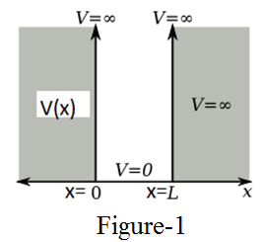
Prerequisite/Recapitulations
Course Code : BBS01T10
--
1. The allowed energy for 1D potential box,
where m is mass of particle, L is the length of potential box and n are positive integers like 1, 2, 3, 4, 5....
The allowed energy for 3D cubical potential box
The potential energy within the 1D crystal or box is
V(x) = 0 for o < x < L
V(x) = ∞ for x ≤ 0 and x ≥ L
----------(1)
where n_{x}, n_{y} and n_{z} are three quantum numbers which are only positive integer value.
where n²= n_{x}² +n_{y}² +n_{z}² ------------(2)
.

Slide 5
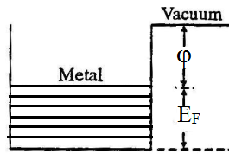
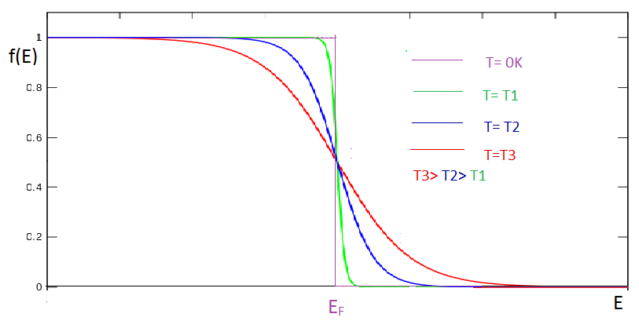
Prerequisite/Recapitulations
Course Code : BBS01T1002 Course Name: Semiconductor Physics
--
2. The Fermi-Dirac Distribution: The Fermi-Dirac distribution applies to Fermions
particles with half-integer spin
obey the Pauli Exclusion Principle.
The Fermi-Dirac Distribution
f(E) the probability for the occupation of a particular energy level E by an electron then
where k_{B} is Boltzmann's constant, T is the absolute temperature, E is the energy of the particular energy level E, and E_{F} is the Fermi energy, the energy of the highest filled level at absolute zero.
At T = 0K,
For E < E_{F},
and for E > E_{F},

Slide 6
Introduction
Density of energy states is defined by the number of allowed energy states present in unit volume at a given energy.
Since even at highest energy, the difference between neighbouring energy levels is as small as 10⁻⁶ eV, in a macroscopically small energy interval dE there are still many discrete energy levels. So the concept of density of energy states is introduced.
The Fermi energy, E_{F} is the energy of the highest filled level at absolute zero.

Slide 7
Density of Energy States
--
Number of energy states with a particular value of E, depends on the how many combinations of the quantum number (n_{x} , n_{y} , n_{z}) result in the same value n. [From equation (1) ]
A space of points is constructed with the values of n_{x} , n_{y} , n_{z}
Each point (n_{x} , n_{y} , n_{z}) with positive integer values of coordinates represents an energy state.
A radius vector n from the origin is drawn to a point n_{x} , n_{y} , n_{z} in this space and according to equation (2) [n²= n_{x}² +n_{y}² +n_{z}² ] all points on the surface of a sphere of radius n will have the same energy.
n represents a vector to a point n_{x} , n_{y} , n_{z} in three-dimensional space.
In this space every integer specifies a state, that is a unit cube contains exactly one state.
The number of states in any volume is just equal to the numerical value of the volume expressed in units of cubes of lattice parameters.

Slide 8
Density of Energy States
--
Number of available states within a sphere of radius n=
Number of available states within a sphere of radius (n+dn) =
The factor 1/8 accounts for the fact that only positive integers are allowable and thus only one octant of the sphere alone be considered.
Number of available states within n to (n+dn) =
[Neglecting higher order terms of dn]

Slide 9
Density of Energy States
Number of available states within n to (n+dn)
From Equation (1),
Number of available states within E to (E+dE) ,
Z’(E) dE =
Z’(E) dE =

Slide 10
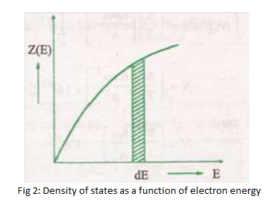
Density of Energy States
It should be remembered that the Pauli’s exclusion principle permits two electrons in each state, so that the number of energy levels actually available are
Z’(E) dE= 2
Z’(E) dE=
-------------------------------------(4)
Density of energy states having energy values lying between E and E+dE,
Z(E) dE = Z’(E) dE/ V=
, [As L³= V]

Slide 11
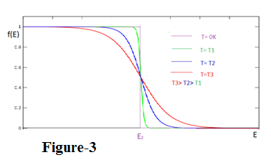
Expression of Fermi Energy
Number of electrons in a system that have energy E to E+dE is N(E) dE = Z’(E) dE F(E) where F(E) is the Fermi function
N(E)dE =
( Using eqn (4))
Total number of electrons, N = ∫ N(E)dE
At absolute zero, the distribution f(E) is simple and all states up to Fermi level are filled and those above E­_{F} are empty.
For T=0K, f(E) =0 for E>E_{F} and f(E) = 1 for E<E_{F}
Total number of electrons, N = ∫ N(E)dE =

Slide 12
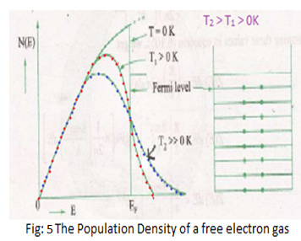
Expression of Fermi Energy
Total number of electrons, N =
N =
Number of electrons per unit volume= density of electrons,
n= =
E_{F} =
= 0.58 x 10⁻³⁷ n^{2/3} Joule
The value of E_{F} gives the top most energy level at absolute zero.

Slide 13
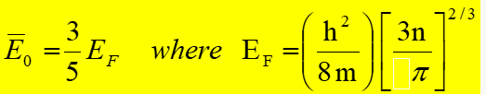
Mean Energy of Electron Gas at absolute Temperature zero
Mean Energy of electron at 0K is
U₀ =
U₀ =

Slide 14
Practice Questions
Define density of energy states and derive its expression.
Define Fermi Energy. Derive its expression.
Calculate the Fermi Energy for sodium. Given Atomic weight is 23gm/mole, density of sodium 0.971gm/cm³ (Assume one free electron/atom)
If the Fermi energy is 10eV, what is the mean energy of electron at 0K.

Slide 15
References
1. J. Singh , Semiconductor optoelectronics, Physics and Technology, Mc-Graw –Hill Inc. 1995.
2. S.M. Sze, Semiconductor Devices: Physics and Technology, Wiley 2008.
3. Pillai S O, Solid State Physics,( 2010), sixth edition, New Age International (P) Ltd. ISBN-9788122427264.
4. https://www.youtube.com/watch?v=tFSZUHRQa3k
5. https://www.youtube.com/watch?v=z7YGS67GETo&t=216s5.

Slide 16
School of Basic and Applied Sciences
Course Code : BBS01T1002 Course Name: Semiconductor Physics
Thank you

